Slide 1

Congenital Abdominal Wall Defects
Prof. Dr. Y. Hakan Çavuşoğlu

Slide 2
History
Newborns with abdominal wall defects were reported in the first century AD by Celsus.
Omphalocele is described in the sixteenth century printed works of Paré, and Lycosthenes may have been the first to describe gastroschisis at about the same time.
The first successful repair of omphalocele was reported by Hey in 1802.
In 1873 Visick described the successful repair of gastroschisis.
In 1967 Schuster introduced staged reduction of large omphaloceles with prosthetic material.
Notes:
Ambroise Pare; French military surgeon, defined the modern wound care.

Slide 3
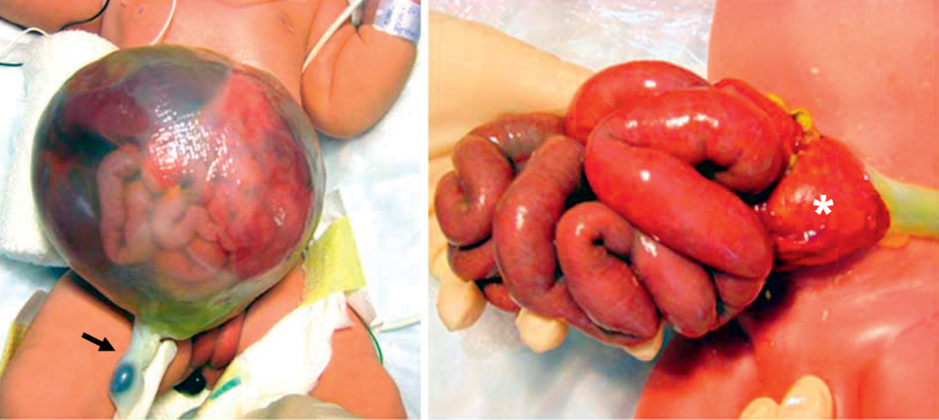
Abdominal wall defects are divided as omphalocele and gastroschisis.

Slide 4
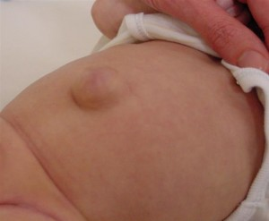
Umbilical hernia is distinguished from these anomalies by two features:
  The defect is covered by normal skin, and
  it is only rarely present at birth, instead usually becoming apparent in the first weeks or months of life.

Slide 5
Embryology and Etiology
The abdominal wall forms during the 4th week of gestation when differential growth of the embryo causes infolding in the craniocaudal and mediolateral directions.
During the 6th week, rapid intestinal and liver growth leads to herniation of the midgut into the umbilical cord.
By week 10, the midgut returns to the abdominal cavity.
It is thought that an omphalocele develops due to a failure of the viscera to return to the abdominal cavity.
The etiology for gastroschisis is less clear. One theory suggests that gastroschisis results from failure of the mesoderm to form in the anterior abdominal wall.
Notes:
Abnormal involution of the right umbilical vein leading to weakening of the body wall

Slide 6
Gastroschisis

Slide 7
Gastroschisis
In gastroschisis, intraabdominal organs herniate from a fascial defect right to the umbilicus.
A sac is absent and the umbilical cord is attached to the umbilicus.
In gastroschisis the liver is never herniated and in addition to the large and small intestine, the stomach and possibly a gonad can sometimes be herniated as well.
At birth the bowel can appear perfectly normal, but more than 20 minutes after birth, the extruded intestine may be thickened and covered with a fibrinous exudate matted together so that individual loops cannot be distinguished.

Slide 8
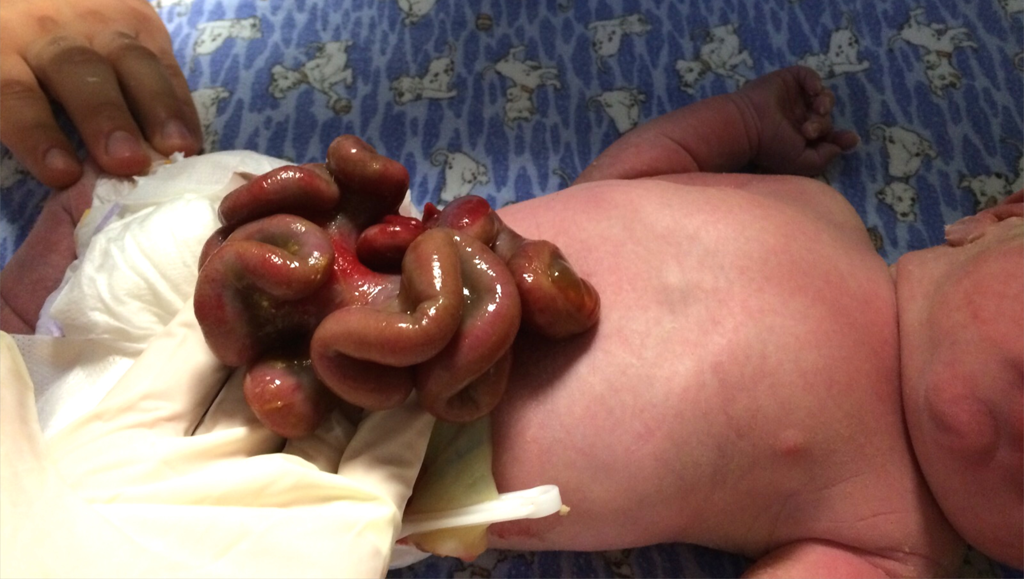

Slide 9
Incidence and Diagnosis
Gastroschisis occurs in 1 in 4,000 live births.
An increased incidence in young mothers has been documented.
The majority of pregnancies complicated by gastroschisis are diagnosed sonographically by 20 weeks’ gestation.
Maternal serum α-fetoprotein (AFP) level, is universally elevated in the presence of gastroschisis.
Detection of bowel loops freely floating in the amniotic fluid and a defect in the abdominal wall to the right of a normal umbilical cord are diagnostic of gastroschisis.

Slide 10
Incidence and Diagnosis
Gastroschisis occurs in 1 in 4,000 live births.
An increased incidence in young mothers has been documented.
The majority of pregnancies complicated by gastroschisis are diagnosed sonographically by 20 weeks’ gestation.
Maternal serum α-fetoprotein (AFP) level, is universally elevated in the presence of gastroschisis.
Detection of bowel loops freely floating in the amniotic fluid and a defect in the abdominal wall to the right of a normal umbilical cord are diagnostic of gastroschisis.

Slide 11
10% of cases was associated with unrelated defects.
Concomitant bowel atresia is the most common associated anomaly, with rates ranging from 25%.
Patients with gastroschisis and an associated gastrointestinal condition such as atresia, perforation, necrosis, or volvulus as a separate entity with a poorer outcome. This is usually called complicated gastroschisis.

Slide 12
Perinatal care

Slide 13
Perinatal care
The delivery method should be at the discretion of the obstetrician and the mother, with C-section reserved for obstetric indications or fetal distress.
No benefit of preterm delivery, and a recent study shows increased morbidity with preterm delivery.

Slide 14
Management
Neonates with gastroschisis have significant evaporative water and temperature losses from the open abdominal cavity and exposed bowel.
Appropriate intravenous access should be obtained and fluid resuscitation initiated (~140±45mL/kg/day).
IV broad-spectrum antibiotics.
Nasogastric (NG) decompression is important to prevent further gastric and intestinal distention.
Routine endotracheal intubation is not necessary.
The bowel should be wrapped with plastic wrap or the infant placed partially in a plastic bag to reduce evaporative losses and improve temperature homeostasis
The neonate should be positioned on the right side to prevent kinking of the mesentery with resultant bowel ischemia.

Slide 15
Surgical management
The primary goal is to return the viscera to the abdominal cavity while minimizing the risk of damage due to trauma or increased intra-abdominal pressure.
The two most commonly used treatment options are;
  attempted primary closure,
  placement of a silo followed by serial reductions and delayed closure.
Urgent primary closure of gastroschisis is commonly practiced in neonates in whom reduction of the herniated viscera appears possible.

Slide 16
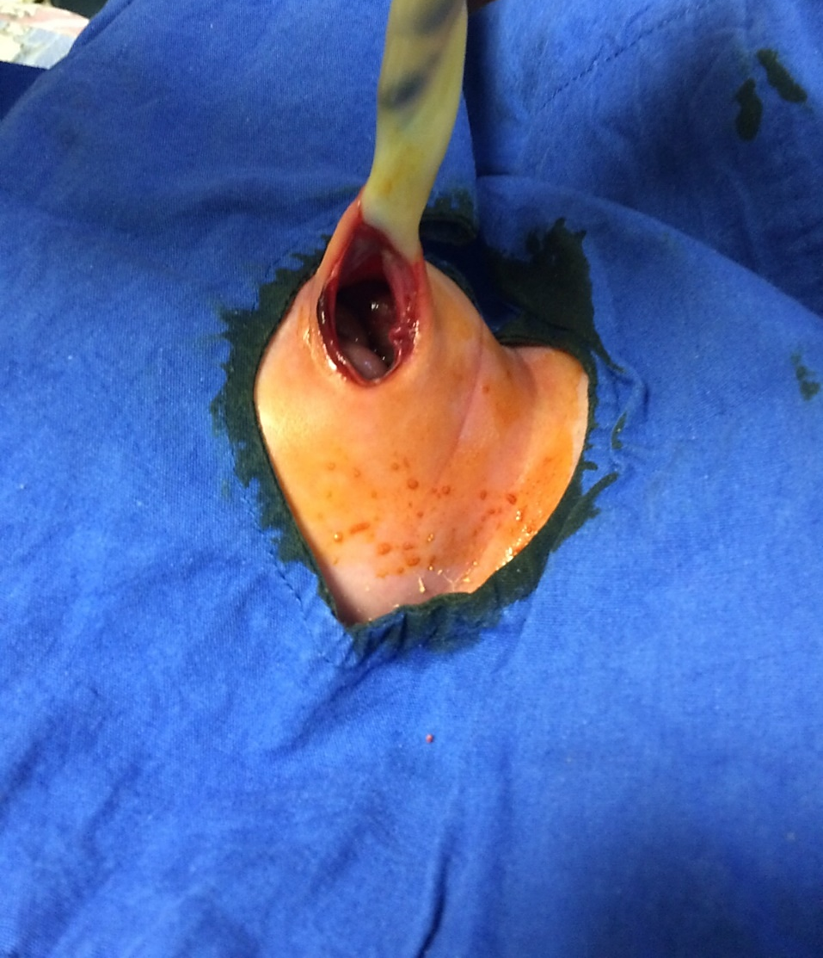
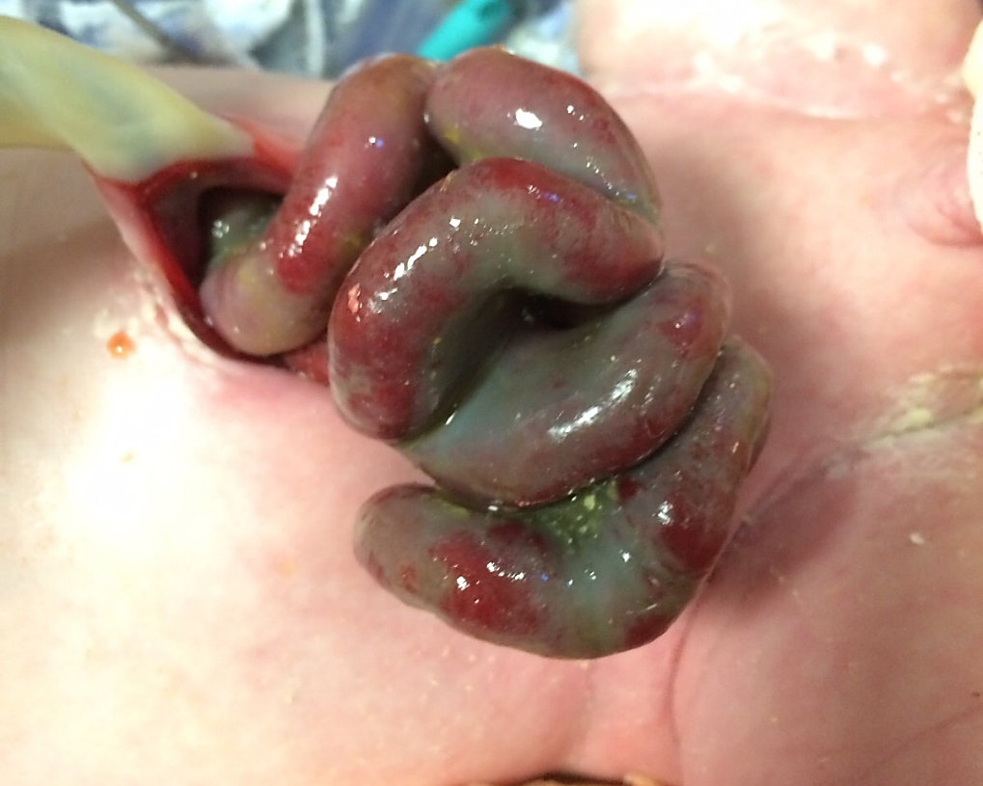

Slide 17
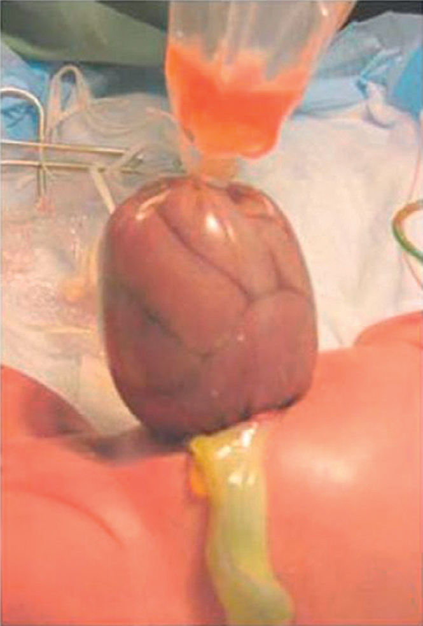
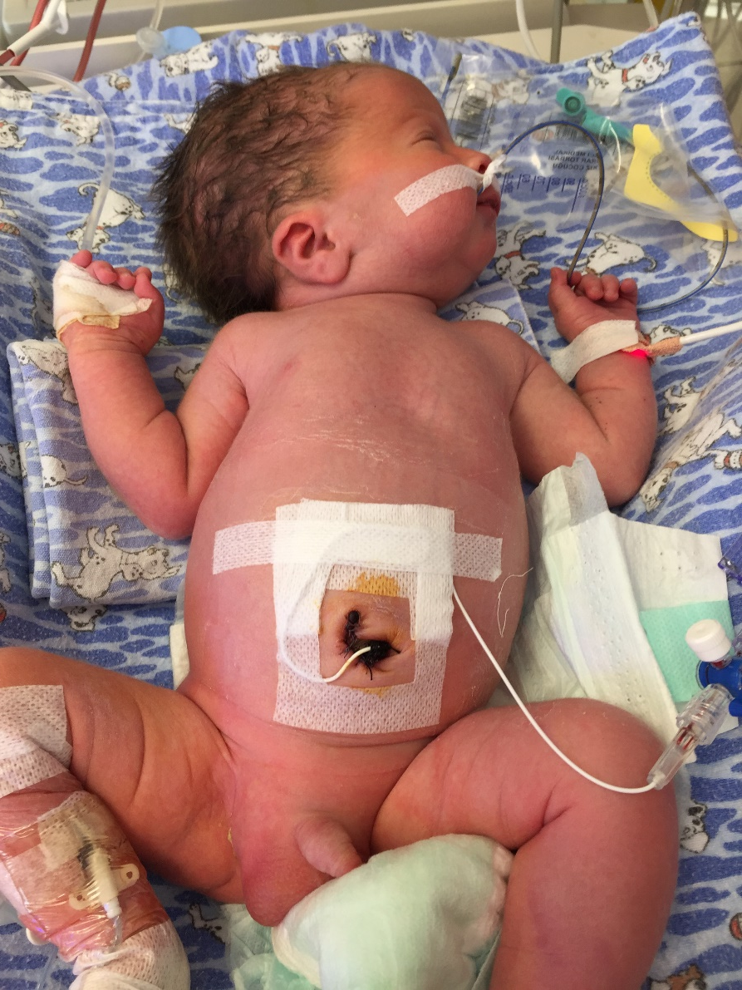

Slide 18
Postoperative Course
If primary closure has been accomplished, the majority of patients will require mechanical ventilation for a number of days.
Gastroschisis is associated with abnormal intestinal motility and nutrient absorption, both of which gradually improve in most patients.
Introduction of enteral feeding is often delayed for weeks while awaiting return of bowel function.
During this waiting period, NG decompression and parenteral nutrition is required.
When bowel activity occurs, enteral feeds can be started and slowly advanced.
Long-term outcomes for patients born with gastroschisis are generally excellent.
The survival rate for gastroschisis is over 90%.

Slide 19
Omphalocele (exompholos)

Slide 20
Omphalocele
A midline abdominal wall defect that the intra abdominal organs herniate to a hernia sac.
In addition to the large and small intestine, liver, bladder, stomach, ovary, and testis also may herniate.
A sac is always present and the umbilical cord inserts on to the sac.
The sac consists of amnion, Wharton’s jelly, and peritoneum.
Location of the defect is in the mid-abdominal or central region, but may occur in the epigastric or hypogastric regions.

Slide 21
Incidence and Diagnosis
The diagnosis of omphalocele can be made by two-dimensional ultrasound at the time of the normal IU18th week ultrasound evaluation.
The incidence of omphalocele at birth is 1 in 4,000–6,000.
Associated structural anomalies generally 50% (35-70%).
Ultrasound evaluation is very useful for the detection of associated anomalies in these infants.

Slide 22
Perinatal care
Pregnancies are usually allowed to come to term, and spontaneous labor and vaginal delivery is preferred.
However, despite the lack of data, many neonates with giant omphaloceles are delivered by C-section because of the fear of liver injury.

Slide 23
Management
After delivery, a thorough search for associated anomalies is important.
All neonates should undergo an echocardiographic evaluation for cardiac anomalies (up to 50 percent of cases),
Abdominal ultrasound for renal abnormalities.
Neonatal hypoglycemia should alert the practitioner to the possibility of Beckwith–Weidemann syndrome.

Slide 24
Beckwith-Wiedemann syndrome
A growth disorder characterized by
macrosomia, macroglossia, visceromegaly,
embryonal tumors (e.g., Wilms tumor, hepatoblastoma, neuroblastoma, and rhabdomyosarcoma),
omphalocele,
neonatal hypoglycemia,
ear creases/pits,
adrenocortical cytomegaly, and
renal abnormalities.
Early death may occur from complications of prematurity, hypoglycemia, cardiomyopathy, macroglossia, or tumors.

Slide 25
Management II
Infants with an omphalocele do not have as significant fluid and temperature losses as those with gastroschisis, but these losses are higher than those with an intact abdominal wall.
The sac itself can be covered with saline-soaked gauze and an impervious dressing to minimize these losses.
IV fluids and broad spectrum antibiotics
An NG tube should be inserted and placed to suction.
Routine endotracheal intubation is not necessary.
In some cases, the omphalocele sac may have ruptured either prenatally, during delivery, or postnatally

Slide 26
Surgical management
Treatment options depend on;
  the size of the defect,
  the baby’s gestational age, and
  the presence of associated anomalies.

Slide 27
Surgical management
Immediate Primary Closure
  Defects that are less than 4cm (1.5cm) in diameter are referred to as hernia of the umbilical cord and are repaired shortly after birth without any issues as long as there are no associated anomalies.
  The defects that are larger, but still easy to close without much loss of abdominal domain can also be closed soon after birth.
  Primary closure consists of excision of the sac and closure of the fascia and skin over the abdominal contents.
Staged Neonatal Closure
Delayed Staged Closure
Scarification Treatment
    Using an agent (silver sulfadiazine, povidone-iodine solution, silver-impregnated dressings, neomycin, and polymixin/bacitracin ointments)
    that allows an eschar to develop over the intact amnion sac. This eschar epithelializes over time, leaving a ventral hernia.

Slide 28
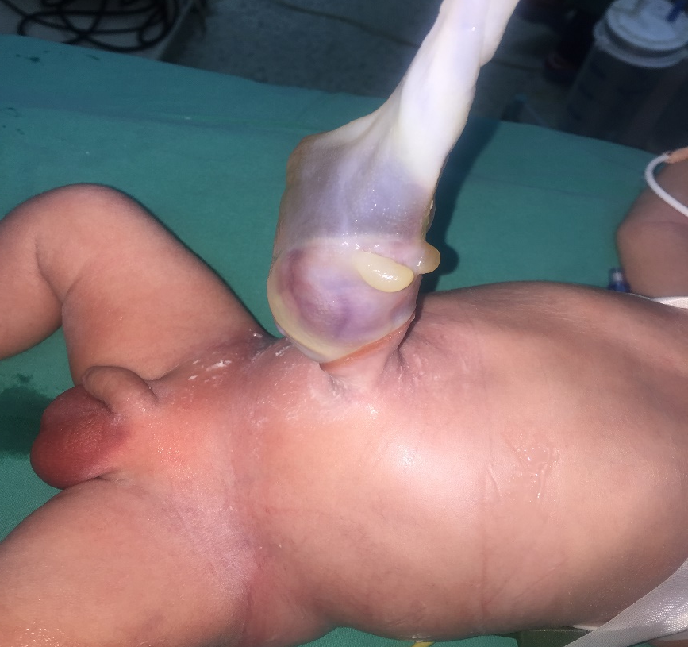
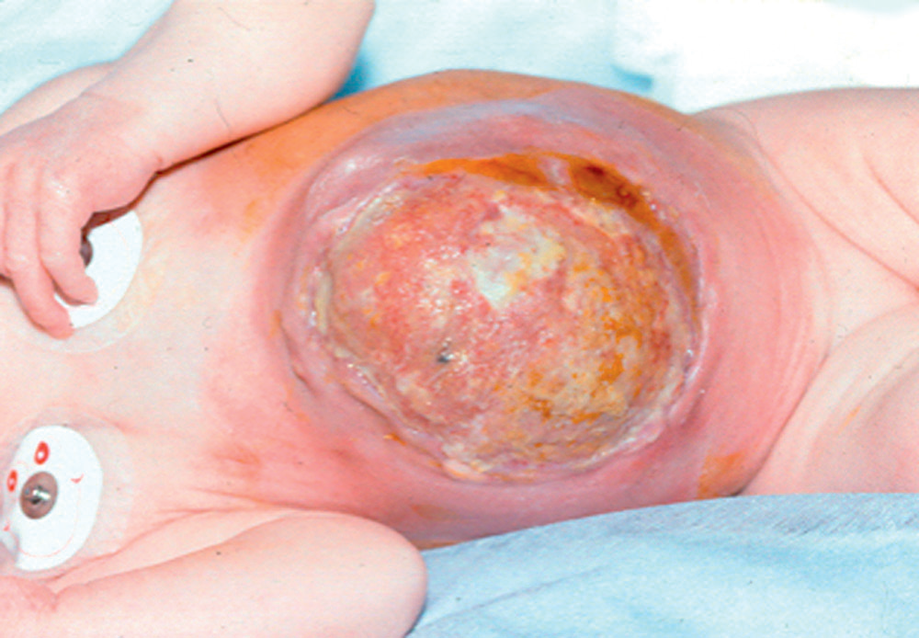
Umbilical cord hernia
Large omphalocele treated by scarification

Slide 29
Postoperative Course
If primary closure has been accomplished, the majority of patients will require mechanical ventilation for a number of days.
Feeding can begin when bowel activity resumes.
A number of long-term medical problems develop in patients with large omphaloceles;
  gastroesophageal reflux (GERD),
  pulmonary insufficiency,
  recurrent lung infections or asthma,
  feeding difficulty with failure to thrive.
Survival rates for omphalocele range from 70% to 95%, with most of the mortality being related to the associated cardiac and chromosomal anomalies

Slide 30
Pentalogy of Cantrell
One unusual form of omphalocele is the cephalic fold defect, or pentalogy of Cantrell
  Supraumbilical abdominal wall defect and the heart is in the sac
  Defect in the pericardium
  Defect in central tendon of the diaphragm
  Intracardiac defect
  Sternal cleft.

Slide 31
Differentiating characteristics between gastroschisis and omphalocele
Characteristic | Omphalocele | Gastroschisis
Herniated viscera
Sac
Associated anomalies
Location of defect
Mode of delivery
Surgical management
Prognostic factors

Slide 32
Differentiating characteristics between gastroschisis and omphalocele
Characteristic | Omphalocele | Gastroschisis
Herniated viscera | Bowel ± liver | Bowel only±stomach
Sac
Associated anomalies
Location of defect
Mode of delivery
Surgical management
Prognostic factors

Slide 33
Differentiating characteristics between gastroschisis and omphalocele
Characteristic | Omphalocele | Gastroschisis
Herniated viscera | Bowel ± liver | Bowel only±stomach
Sac | Present | Absent
Associated anomalies
Location of defect
Mode of delivery
Surgical management
Prognostic factors

Slide 34
Differentiating characteristics between gastroschisis and omphalocele
Characteristic | Omphalocele | Gastroschisis
Herniated viscera | Bowel ± liver | Bowel only±stomach
Sac | Present | Absent
Associated anomalies | Common (50%) | Uncommon (<10%)
Location of defect
Mode of delivery
Surgical management
Prognostic factors

Slide 35
Differentiating characteristics between gastroschisis and omphalocele
Characteristic | Omphalocele | Gastroschisis
Herniated viscera | Bowel ± liver | Bowel only±stomach
Sac | Present | Absent
Associated anomalies | Common (50%) | Uncommon (<10%)
Location of defect | Umbilicus | Right of umbilicus
Mode of delivery
Surgical management
Prognostic factors

Slide 36
Differentiating characteristics between gastroschisis and omphalocele
Characteristic | Omphalocele | Gastroschisis
Herniated viscera | Bowel ± liver | Bowel only±stomach
Sac | Present | Absent
Associated anomalies | Common (50%) | Uncommon (<10%)
Location of defect | Umbilicus | Right of umbilicus
Mode of delivery | Vaginal/cesarean | Vaginal
Surgical management
Prognostic factors

Slide 37
Differentiating characteristics between gastroschisis and omphalocele
Characteristic | Omphalocele | Gastroschisis
Herniated viscera | Bowel ± liver | Bowel only±stomach
Sac | Present | Absent
Associated anomalies | Common (50%) | Uncommon (<10%)
Location of defect | Umbilicus | Right of umbilicus
Mode of delivery | Vaginal/cesarean | Vaginal
Surgical management | Nonurgent | Urgent
Prognostic factors

Slide 38
Differentiating characteristics between gastroschisis and omphalocele
Characteristic | Omphalocele | Gastroschisis
Herniated viscera | Bowel ± liver | Bowel only±stomach
Sac | Present | Absent
Associated anomalies | Common (50%) | Uncommon (<10%)
Location of defect | Umbilicus | Right of umbilicus
Mode of delivery | Vaginal/cesarean | Vaginal
Surgical management | Nonurgent | Urgent
Prognostic factors | Associated anomalies | Condition of bowel

Slide 39
Thanks for your attention
References:
Ashcraft’s Pediatric Surgery, 6th Edition, Elsevier Saunders, 2014
Pediatric Surgery, 7th Edition, Elsevier, 2012
Gastroschisis. In UpToDate, Wilkins-Haug L., Levine D.(Ed) (Accessed on June 7, 2016)

